Slide 1
Generation
5 generations
Vacuum tube
Transistor
IC
Microprocessor
AI

Slide 2
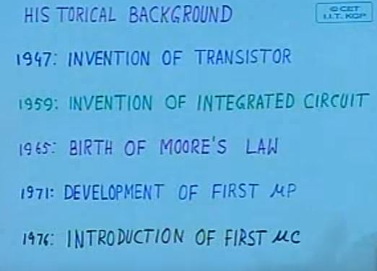
Background

Slide 3
Moore’s Law
Proposed in 1965
Components in IC will be double every years
Modified in 1975
Components density would double every 18 months

Slide 4
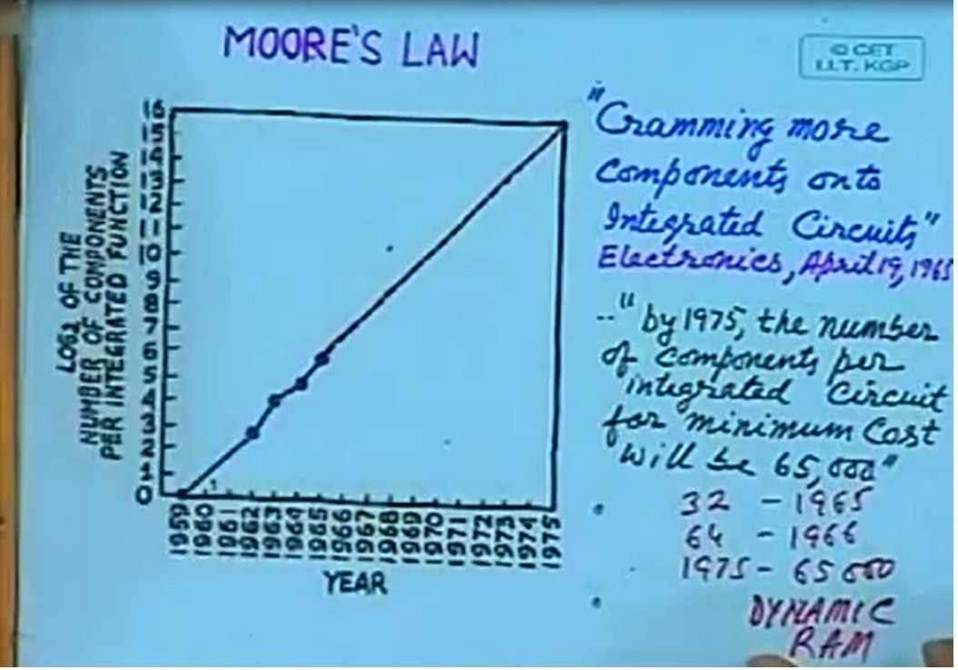
Moore’s Law

Slide 5
History
1971
4004 a 4 bit microprocessor developed by Intel
Microprocessor – CPU on a chip
1976
8048 - first microcontroller
microcontroller- everything put together on a chip

Slide 6
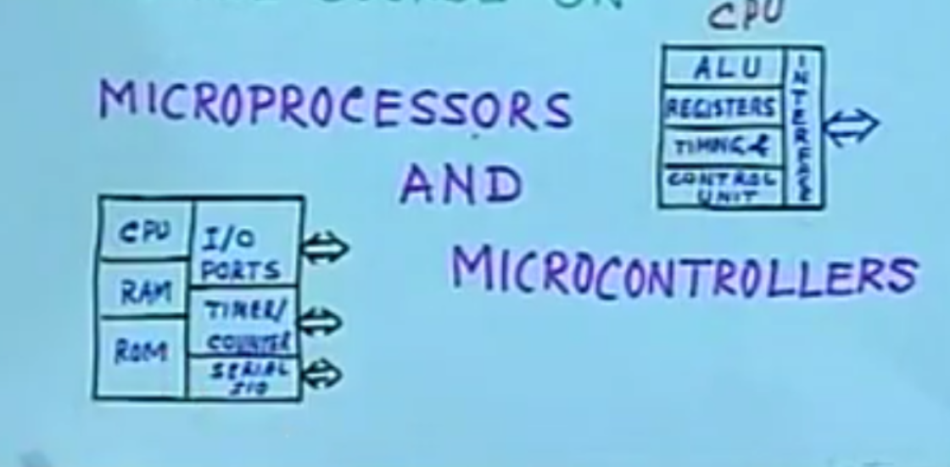
Microprocessor vs Microcontroller

Slide 7
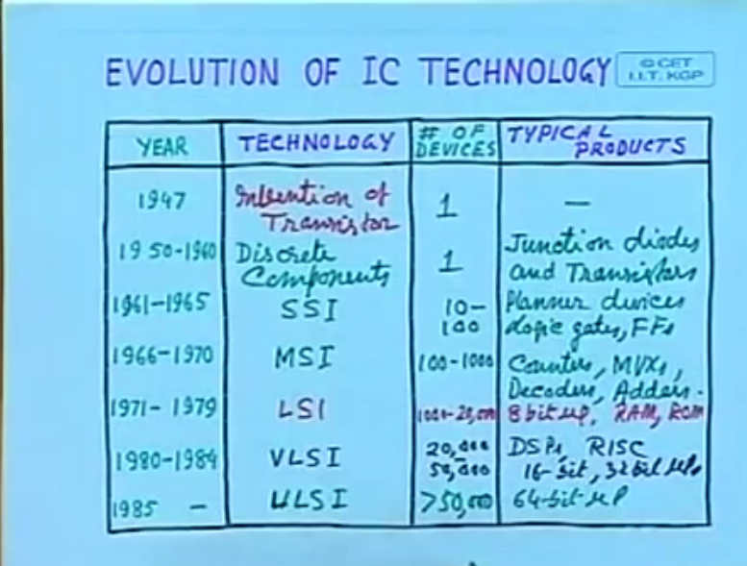
Evolution

Slide 8
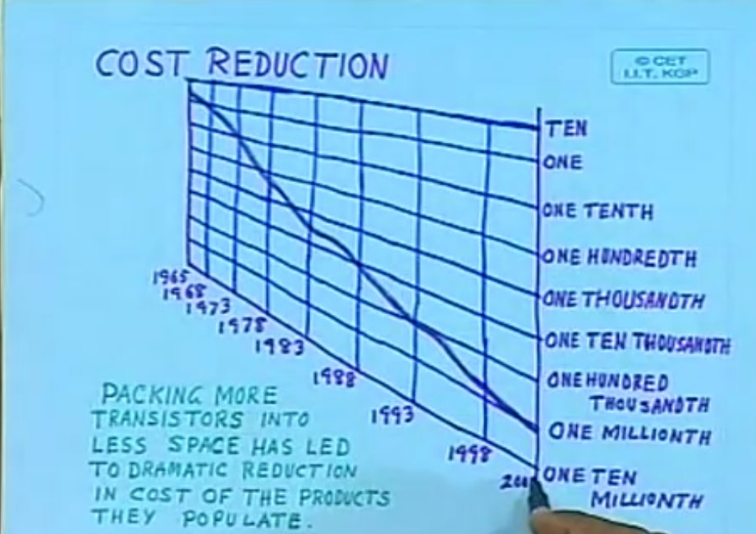
Cost Reduction

Slide 9
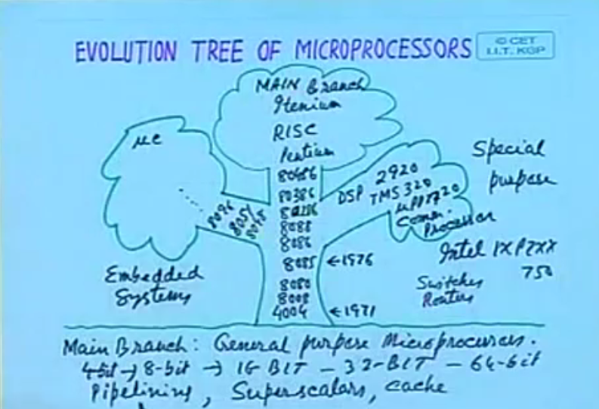
Evolution Tree

Slide 10
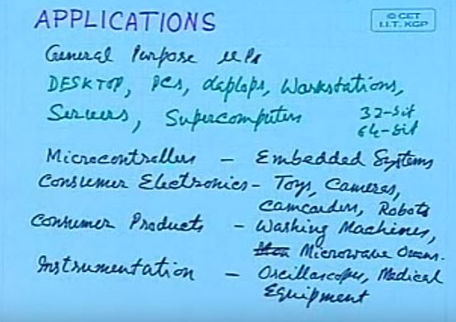
Applications

Slide 11
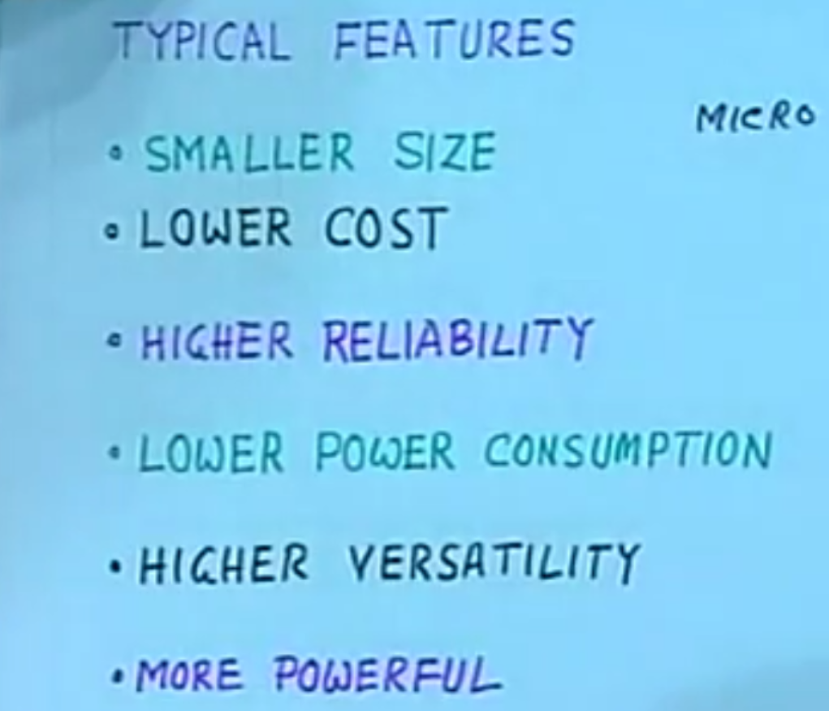
Typical Features

Slide 12
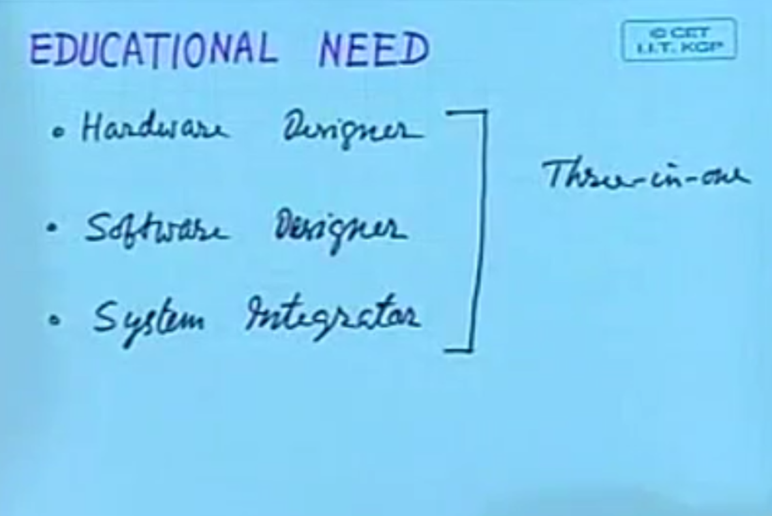
Educational Need

Slide 13
Thank You

